Slide 1

EHB TECHNOLOGY LIMITED
EHB is Technology Based Company
What is EHB
EHB Company connects all the business people and service providers of the world on one platform.
Providing a better and transparent and verified and 5 service quality to both service receivers and service providers.
EHB also works primarily on providing quality service and products.
And providing fastest service of online and physical support to people.
EHB also fully verifies any product and service provider at 05 quality levels.
And working on providing the fastest service.
PENDING>>?

Slide 2

EDR, PSS, EMO Department of EHB
POWERED BY
EDR
Provide ranks to it service provider which will help you know about your desired level .EHB provide five service of qualities.
1.Free 2.Basic 3.Normal 4.High 5.VIP
First level is free
Anyone can acquire this level of service but this service is not guaranteed by company and the next level of services are fully guaranteed.
PSS- PERSONAL SECURITY SYSTEM
How can a client seeking service through EHB come to know about the personal status of the service provider whether he is legal or fraud. This function is performed by our PSS department. it is basically a security agency which goes through the profile of a person or a company gets their documents checked and verified by their respective departments before they start providing their services. it can even impose penalties if found flaws in quality or delay in their service.
Without verifying documents from PSS a person can only offer free service.
It can even block the profile of a person or a company not abiding by its rule.
It also has five levels of quality service.
It verifies all the legal documents, tests skills and examine the abilities of service provider and the ranks him on the site. So that a client come to know about the service provider status.
EMO- EASY MANAGEMENT OFFICE
After going through the above maintained procedure, he them becomes a part of EHB. The company will provide him a back office where he can manage his business online. Its help its client to manage his official work very easily in a very short time.
PENDING?

Slide 3

EHB ADD- Advertisement Company Product Of EHB
POWERED BY
EHB ADD is Products of EHB Company
After upload your add company will verified you add and advertisements.
No anybody can present and advertise any think on it.
You can only run real registered based add on it.
After upload your add company will refer you add to different Department and institution which will be related to your data after verified your data then company will upload you data.

Slide 4

JPS-JOB PROVIDING SERVICE Department Of EHB
POWERED BY
This service offers a platform where skilled people can advertise their skills and acquire jobs and companies, organization and factories can hire a person of their requirement.
JPS is a department of HB Company.
JPS provides complete and five-level verification of all service providers' profiles.
JPS verifies all their degrees and diplomas from the institutions from which they have obtained them.
Before joining the company they will have to pass the test and interview.
And how much experience.
After all these works it will be brought from free to basic level.
There are five total service quality levels.
Free 2. Basic 3. Normal 4. High 5. VIP.
No one can switch to any service other than Direct Free.
You can take any type of service from your own area.
Like your AC is broken.
You will find AC healers in five levels.
All fees will be different. And the quality level of all will be different.
You can choose any level of service provider you want.
The people who are in the free level will not have any responsibility of the company.

Slide 5
EHB- Companies & Departments
EHB Departments Names
1.EDR, 2.EMO, 3.PSS, 4.JPS, 5.EHB ADD.
Lunched Companies.
Go Saller – E-Commerce
Coming Soon Companies.
HPS- Human Performance Solution -Education service
HMS- Health Management Services
SOT- SERVICES OF TECHNOLOGY
OLS- Online Law Services
OBS- Online Book Store
eTUBE- Videos- Audio- FILE
HMS- Homan Machinery Solutions
AG TRAVLING- Advanced Global Traveling Services

Slide 6

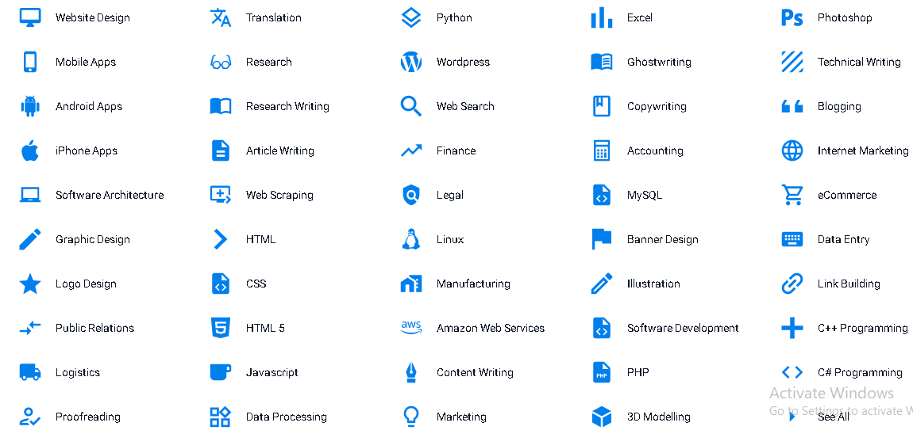
SOT- SERVICES OF TECHNOLOGY Product Of EHB
POWERED BY
Block chain Crypto Currency
SOT providing 4 service quality in the developments
You can choose the level you want to develop.
People from all over the world will be registered with the company at 5 levels.
And the project which was to be developed in a year will be developed in one to two months with this company.
This company will have a management system that after uploading your project will be seen by people related to it all over the world.
And those who can prepare it in minimum time will apply. And in the case of a team, the system will get them to do more in less time.

Slide 7

HPS- Human Performance Solution Product Of EHB
EDUCATION
POWERED BY
Registered Your School Collage Uni Any Kind of Institutes
Create Virtual School Collage Uni and any kind of institute .
Get your institution's syllabus online.
Bring your institution's classes online.
Manage your staff online.
Get students from all over the world at your institution.
Take class work at home in case of student vacation.
Even if the teacher is on leave, give all your classes online work.
Get your books completely online, including video lectures and get them translated into different languages.
Get your personal teacher with normal and high level, The choice is yours. That too from his own area.
EHB SQ-LEVEL
Free
Basic
Normal
High
VIP

Slide 8

HMS- Health Management Services Product Of EHB
POWERED BY
Now take every medical related service at home. With five service quality. Includes normal to high levels.
Hospitals and dispensaries, medical stores, nurses, and doctors and all medical related people from all places will be registered. Who will provide services in their own areas.
All doctors will be verified by EHB company.
Take Video Consultation . Online Check up, personal Doctor, Nurses etc.
You can get your checkup done at national and international doctors.
You can get any level of medical service anywhere at any rate you want.
Patient Health Records
Checkup Physical & Online On Video Call
Remote Monitoring
Appointments
Video Consultation
Patient Questions
Notifications
Patient Portal
Billing & Reports
Mobile Apps
The company's franchisees will be present at every location to provide 24-hour helpline assistance.
All service providers cannot be registered with the company without examination and testing.
And every service provider will have to re-apply in their own field after every 6 months and can work again for 6 months only if they get good marks.

Slide 9

OLS- Online Law Services Product Of EHB
POWERED BY
OLS Law Firm is a renowned full-service law firm based in PAKISTAN. Powered by EHB Company
Our transparent approach with the use of ‘The Law Reporters’, a customized client management portal has helped us in setting a benchmark in the legal fraternity, and our industry specific experience has built an irreplaceable reputation in all the practice areas including dispute resolution, corporate and commercial matters.
We are providing verified law Service. And you can hire any type of lawyer from your city.
24 hours free sport and consultant services .
Litigation-All UAE Courts
Banking Law
Civil Law
Real Estate Law
Maritime Law
Criminal Law
Family Law
Inheritance Law
Company Incorporation
Labour Law
Intellectual Property Law
Sports Law
All service providers cannot be registered with the company without examination and testing.
And every service provider will have to re-apply in their own field after every 6 months and can work again for 6 months only if they get good marks.

Slide 10

Go Seller – E-Commerce
POWERED BY
Go Seller is a online service based company powered by EHB.
You can buy anything related to the market. Which includes vehicles and plots and houses.
Why The Go Seller Has Best Compare To Others Companies
Go Seller has come up with a solution to all these problems Who were running all over the world related to online shopping E-Commerce
Problems In Online Shopping’s
Go Seller – Solution
Delivery time
Go Seller delivers in fifteen minutes to one day.
Product Replacement
Get product replacement within one day
Same product not available
It is the responsibility of the company to provide the correct product to you.
Non-availability of product quality or verified product.
Go Seller provides you PSS and EDR certified and quality based products.
Not Available 24 hours live Call or Physical helpline facility.
24 hours live Call or Physical helpline facility
Do not act quickly on the complaint.
Respond to complaints within 15 minutes
Not having franchise or office of the company in every city
Franchise or company office available in all cities.
Not Your Money Guaranty after putting for Shopping .
Using service quality Basic, Normal, High, VIP, your shopping deposit amount is the responsibility of the company.

Slide 11

OBS- Online Book Store Product Of EHB
POWERED BY
OBS Service providing many tool for managing your book and syllabus with the full Details and in the different languages all over the world OBS Powered By EHB Limited.
It will be a bookstore where you will find various services.
1. All kinds of books in the world.
2. in different languages.
3. With videos tutorial and dictionary.
4. Books will also be published.
5. Those who will build a store on it will also earn from it.
6. It has levels within it. The books that are read the most will be at the top level.
7. Any company organization and educational institution can upload their complete syllabus online.
This company verifies your syllabus and books. And provides a fully verified and transparent syllabus.
And the company is giving four service quality.

Slide 12

eTUBE- Videos- Audio- FILE Company Of EHB
POWERED BY
EHB TUBE like YouTube But we have some Different
EHB TUBE provide 4 Quality of service FREE BASIC NORMAL HIGH VIP
Without free service you can verify you videos with Title and Tag and Thumbnail .
You can not upload moves, Drama and Songs you can only upload Education Based Data , after upload your data you need to select any Company organization and any educational institute which will be related to your data.
If your data is not related to an organization, you cannot be verified.
The company will assign a quality level to your verified data.
But you can earn only with verified data. If your channel is not verified then you can't earn.
Without verification of personal profile you cannot create earning channel. That is, the user can see who legally owns this channel and from where.
No one can upload fake account and fake data except free category.
If the user wants to read something, he can see all over the world who has the highest level and normal level channel in that field. Which must have been passed by various institutions.

Slide 13
AG TRAVLING- Advanced Global Traveling Services
POWERED BY
AG TRAVELING- Advanced Global Traveling Services
This is traveling based services you can.
Book your room, table online.
Book the flight tick.
Book the car.
Orders the food online
You can travel to anywhere AG Traveling provide you Verified traveling agencies.

Slide 14




HMS- Homan Machinery Solutions
POWERED BY
Be it motorway or dirt roads, city or village,
in case of vehicle breakdown,
all types of service can be reached in just fifteen to thirty minutes.
Buying and selling of vehicles & Repairing
Buying and selling of Bike & Repairing
General Auto Maintenance
Computerized Scanning
Manufacturer Recommended Service
Brake Service or Replacements
Catalytic Converter Cleaning
Buying and selling of heavy machinery & Repairing
You can buy and sell any type of machinery.
And can take the service of mechanic and operator at any place for its repairing, Like
Car AC, Tv, Cooler, UPS, Generator etc.
Our Process
Choose your repairs
Select your car, tell us what's wrong, and we'll find the right mechanic for you.
Pick a date, time & location
Your mechanic will come to whichever address suits you best, at the date and time of your choice.
Sit back & relax!
No need to go to the garage - just sit back, grab a drink, and enjoy your favorite show.

Slide 15
Vehicle Services
Car Diagnostic
Engine Analysis
Engine Overhaul
Oil Change & Oil Filter Replacement
Engine Replacement
Check Engine Light Codes
Tune-Up
Chassis & Suspension Repair
Schedule Service
Fluid Services
Trip Inspections
Fuel System Repair & Maintenance
Ignition System Repair & Maintenance
Belt Replacement
Engine Performance Check
Hose Replacement
Radiator Replacement
Water Pump Replacement
Throttle Body Cleaning
Air Filter Change
Brake Pads – Rear Brake Shoe/Pad
Spark Plugs Cleaning/Changing
Accident Repair
Fender Repair & Replacement
Dent Repair
Paint Repair
Windshield Replacement
Bumper Repair & Replacement

